Slide 1
Center of excellence
Thomas Mittelbach
Thomas Mittelbach
Managing Business Analyst
November │ 2022

Slide 3
Capgemini is recognized as industry experts

Slide 4
MY FAULT, IF ONLY I HAD A CoE TEAM TO BACK ME UP. THIS WOULD`NT HAPPEN......BUHUU

Slide 5
Our Adoption Planning Workbook will guide you through the adoption planning process
Assess readiness
Assemble your team
Onboard employees
Partner with your team to clearly outline business strategy and key success metrics. Align business and technical needs to maximize outcomes.
Determine the overall organizational readiness including leadership alignment, user groups, and technical, governance, support, and feedback channels.
Tap into the technical and business change agents. Recruit multi-disciplinary teams of executive sponsors, technical talent, core stakeholders, change agents, and champions.
Plan the rollout cadence based on early adopter pilot program, Champion readiness, and planned scope of change.
Build awareness, deployment, training, and feedback collection into the plan to continuously drive engagement and usage.
Define strategy and scenarios
Build plan

Slide 6
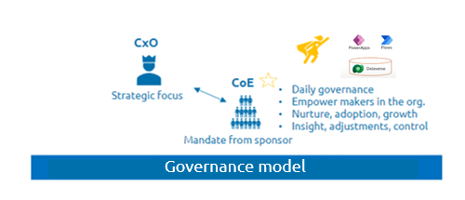
GOVERNANCE – THE FOUNDATION OF COE
CxOs’ input to BPM is critically important, but they rarely have the time.
Let the CxO focus on strategic BPM by giving CoE the mandate to handle day to day Governance and silo obstacles.
A CoE that has clear backing from a BPM-aware CxO, acts as an extension of the CxO, helping to ensure that BPM is taken seriously by the whole organization.
The roles of the CoE must include:
Aligning goals and objectives
Resolving disputes about priorities and methods
Allocating resources
Support from the CxO
Support by change management team!

Slide 7
Assemble your team
Any successful project begins by bringing the right team together. Your project stakeholders should include representatives across your organization who have accountability for project success.
Role | Responsibilities | Department | Who?
Executive Sponsor | Communicate high-level vision and values of the Microsoft Power Platform to the company | Executive Leadership | [Enter Name Here]
Success Owner | Ensure the business goals are realized from the adoption process | Any department | [Enter Name Here]
Champions | Help evangelize Power Platform. Create a circle of influence and can feed back to the Adoption team what works/what doesn't work. | Multiple departments | [Enter your Champions Lead here]
Training Lead | Manage and communicate training content about Power Platform – can be internal or external vendor | IT or other | [Enter Name Here]
Department Leads (Stakeholders) | Identify how specific departments will use the Power Platform and encourage engagement | Any department (management) | [Enter Name Here]
Communication Lead | Oversee company-wide communications about the Power Platform | Corp Communications, IT or other | [Enter Name Here]
Power Platform Admin Team | Responsible for establishing an environment strategy, setting up data loss prevention (DLP) policies, and managing users, capacity, and licensing. They also make data available to makers through connectors, integration, or migration. | IT | [Enter your Admin Lead Here]
Power Platform Nurture Team | Organizes app-in-a-day events and hackathons, provides mentorship to makers, ensures new makers get off to a good start, and generally evangelizes the platform. Provide business change management. | Multiple departments | [Enter your Nurture Lead Here]
Note: Though we recommend having each of these roles fulfilled, in smaller organizations some of these roles may be carried out by the same person.

Slide 8
Power Pods
You build it – you run it: the roles and structure needed for successful POD-based model implementation
The POD-based model is centered on the DevOps best practice of “you build it – you run it.” This means POD teams assume full ownership and accountability for a product from build to support.
A POD-based model consists of dedicated roles with complementary skills that are confined to a POD, shared roles that are spread across the PODs as needed, and CoE teams that define standards:
Dedicated roles – POD model dedicated roles include:
Scrum Master
Product/Tech Lead (for detailed design/architecture)
Technical/Business Analyst
UI Developer(s)
Back-end Developer(s)
SDET (Software Development Engineers and Testers)
DevSecOps Engineers and Cloud Engineers.
Shared roles – POD model shared roles used across PODs include:
Governance roles – Product Director and Product Owner
Coaching roles – Agile/DevOps Coach(s)
Architects – Enterprise, Application, Data, Cloud, Security, etc.
SRE – Site/Service Reliability Engineering Specialists
Source: https://www.capgemini.com/insights/expert-perspectives/how-to-design-and-implement-a-pod-based-devops-operating-model/

Slide 9
Define your goals
Microsoft Power Platform’s low code approach to solution delivery has enabled thousands of organizations around the world to use technology to transform their business. How will it transform yours? Think about what’s in scope for your adoption and what your initial priorities are.
Goals
Example: Be productive on the road.
Example: Reduce IT support and maintenance costs.
Example: Increase digital skills and ability
Example: Improve long organizational processes.
How it benefits my organization
Example: Provides field sales teams ways to easily update customer details and contracts without having to go back to the office.
Example: Reduce Shadow IT workloads in local Excel and Access files that often have high IT support cost when they become critical by migrating them to Power Platform.
Example: Empower employees to be in the driving seat of digital transformation by enabling them to digitize their own processes
Technicians can easy interact with D365 Field Service data through a mobileApp. Results in more work orders being completed
Notes:
Once you complete this section, refer to it throughout your project to ensure you are on track for your desired end-state.

Slide 10
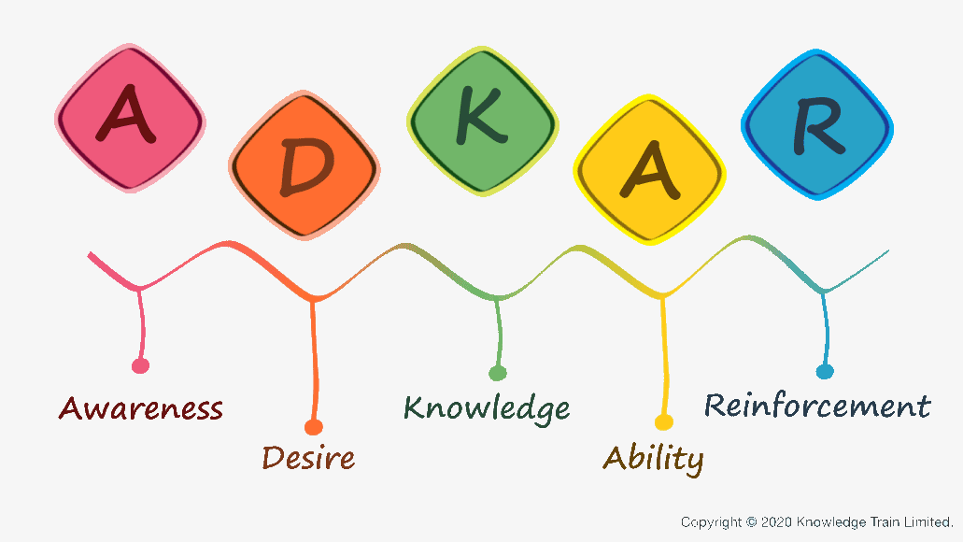
CENTER OF EXCELLENCE and PROCSI - A good fit
Training Plan
Viva Learning Pathway
On site training
CoP learning assets
Communication plan
Ambassador network
Share how PP fits with the digital strategy
Communication plan
Local champions w/CoE team adresses resistance
Celebrate success early and often
Users tell and show new ways of working
E-learnings
Guide Lines and best practises
Knowledgebase, wiki
Community - CoP
Notes:
Employee experience journey kan inkludere PP elementer som COE vedlikeholder.

Slide 11
Resistance is normal
Resistance is to be expected…
… and needs to be anticipated
Resistance is to be expected…
Anticipation allows you to be proactive in identifying and managing resistance.
Don’t be surprised, be prepared.
Start thinking of resistance not as something to overcome, but as something to uncover.
It is the natural reaction to change.
People are comfortable with the status quo.

Slide 12
Champions community
Set Team
At the heart of growth is a community, a place for people to collaborate, share ideas, and discover new ways to apply technology to achieve more. It is a safe place to ask questions, to share knowledge, and to expand skillsets.
Organizations that experience successful adoptions create a digital culture that fosters an environment of ongoing learning as well as provides tools such as forums, regular events, and speaking opportunities. They make sure that every person in the organization can come together at regular intervals to socialize, share their knowledge, and explore new possibilities.
Leaders who want to create a digital culture will put a framework in place for the community inside their organization to break down geographic and organizational silos.
Product Owner
App in a
Day Trainer
Project Manager
Microsoft Certified
Team Members
Citizen Developers
Specific
Skills*
Pro Developers
“It’s been particularly inspiring when makers can see apps developed by their colleagues that solve problems similar to their own.”
– Claes Söderström, Cross Delivery Coordinator, H&M Group

Slide 13
Sample rewards and recognition model
Theme | And the winner is? | What’s the prize?
Champion of the week | The individual Champion who answered the most questions in the internal community. The individual Champion who created the most apps or flows that are used for production scenarios. | Highlight in internal communication, intranet Gift card ‘Thank you’ email from manager or Executive Sponsor Power Apps Premium licenses for a year Conduct lunch and learn session
Solution of the week | The individual solution that solved the best business process, saved the most money, or increased productivity. | Gift card to makers ‘Thank you’ email from manager
Most active business area | The team with the most production apps or flows in use. | ‘Thank you’ email from Executive Sponsor Pizza party for the winning business area Feature on company intranet site
Most creative idea | Most creative idea submitted in the Innovation Backlog. | Lunch with Key Sponsor Gift card ‘Thank you’ email from Executive Sponsor

Slide 14
Ideas to scale involvement across your organization
How are you going to scale within your organization?
Example: Organize weekly lunch and learn sessions
Arrange contests and celebrate makers creating solutions, business value
Local champions reaches out to members of different Communities of practise to spark initiatives and help new makers get going
Leadership communicates challenges they want solutions for: Asks for ideas and acknowledge/rewards them.

Slide 15
Complete the technical readiness checklist
Fill this section out
Technical Readiness is key to ensuring your organization is ready for launch. Use the checklist to identify items that need to be completed before go-live.
Readiness item | Complete? Y/N | Plan to complete
Review security and compliance capabilities with security teams
Review platform capabilities and decide on a strategy of what tools to launch
Review platform license and capacity capabilities
Assign Power Platform Admin role
Allow-list required IP addresses and URLs (Power Apps, Power Automate)
Implement Data Loss Prevention and tenant-isolation policies
Review Power Platform analytics capabilities
Establish an environment strategy
Prepare the help desk

Slide 16
What if
Executive Management struggles to understand the businessvalue of digital transformation?
Identify one or two solutions created on the Power Platform
Invite CxO to showcase digital capabilities and business value
Communicate the need for a change management journey that is connected to the digital transformation strategy

Slide 17
CoE operating model Supporting the employee journey towards the Low Code Platform
Customer/
Business Units
Dedicated Low Code Platform Centre of Excellence
Iterative Development Activities
Program Owner
UXI and CoE Architect perform the functionality assessment ( 1 -3 days)
Design Thinking Customer Workshop (45 min – 60 min)
Application Architecture Design (3 – 10 days)
Data owner/processor
Application Requestor
E-Mail/Peer to peer meeting
Application Owner
Application development &UAT tests
Citizen Developer
Application life cycle management
Application handover & presentation
Communication how and where to raise the need for the new component is sent.
Webinars/trainings how to use an app are available.
Updated procedures are in place.

Slide 18
Demo Use Case – HR Services
Get CV
Identify candidate
On both desktop and mobile
Upload photo or PDF file
Using AI Builder, we can identify candidate profile
All data is exported to HR System
Provide Recommended Profile
Calculate Candidates scoring
Insights into action
Act faster through one workspace
Power Apps
Power BI
DataVerse
Power Automate and Power Virtual Agent in Teams
Integration with HR Systems
Book Deep-Dive with candidate
Supports integrating data from multiple sources
Data from AI Builder goes to DataVerse
Find a timeslot that fits the candidate and the hiring manager
Accept your future team member

Slide 19
Thank you!
Thomas Mittelbach
Managing Consultant Microsoft DCX
thomas.mittelbach@capgemini.com
412 76 911

