Slide 1
Power Apps Visual – Power BI
Knut Stie von Krogh
10/11-2022

Slide 2
Table of content
01 | Executive summary
02 | About Avanade
03 | Solution Approach & Scope
04 | Delivery Methodology & Project Timeline
05 | Project Team
06 | Commercials

Slide 3
We are Avanade
Created in 2000 by Microsoft and Accenture, Avanade is the leading provider of innovative digital and cloud services, business solutions, and design-led experiences delivered through the power of people and the Microsoft ecosystem. Avanade is the delivery engine for Microsoft related services within Accenture.
The Leading Microsoft Experts
55,000+
Professionals
80 locations across 24 countries
16 times
Microsoft Global Alliance SI Partner of the Year
The Power of Three
46% of our clients are Global 500 companies
18 Microsoft
Gold Competencies
End-to-End Services
Emerging Technology
Innovation Studios
Advisory
Services
Solution Delivery
Managed Services

Slide 4
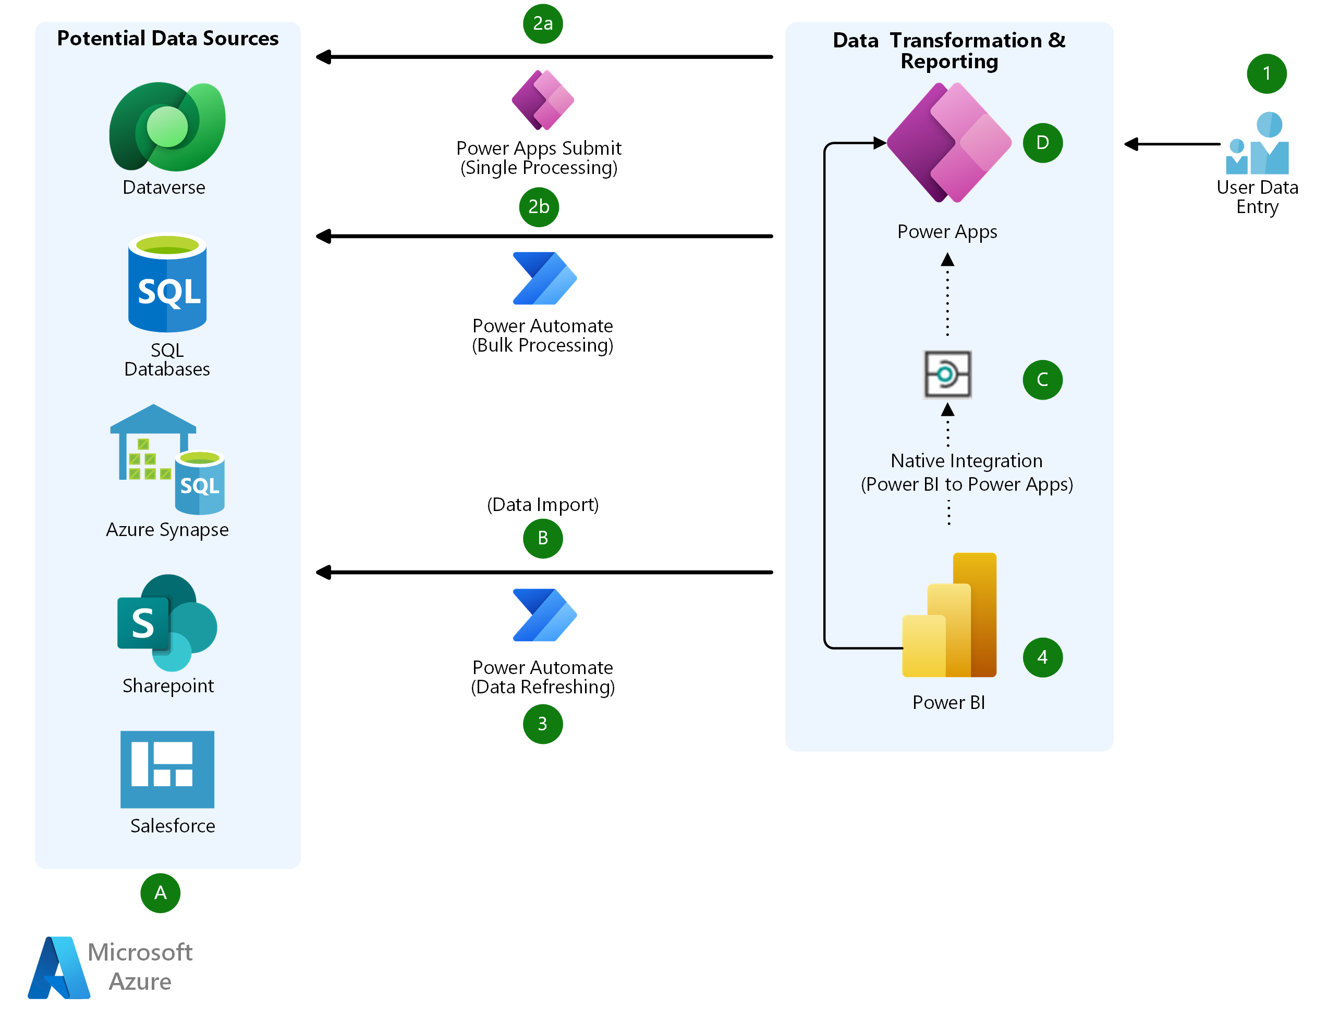
Example architecture

Slide 5
PowerApps Visual use cases
Perform CRUD operations on the data source
Replace old excel forms etc. with something more robust
Perform simulations on the dataset

Slide 6
PowerApps Visual some limitations
The maximum number of records that can be passed from Power BI to Power Apps visual using "PowerBIIntegration" object is limited to 1000.
Power Apps visual doesn't support multi-level embedding of Power Apps in Sovereign clouds. For example, embedding a Power BI report with Power Apps visual to a SharePoint page, or further embedding that SharePoint page to a Teams channel isn't supported on sovereign clouds.
The Power Apps visual can't trigger a refresh of Power BI reports and Power BI data sources from within Power BI Desktop. If you write back data from the app to the same data source as the report, your changes won't be reflected immediately in Power BI Desktop. Changes are reflected on the next scheduled refresh.
The Power Apps visual can't filter the data or send any data back to the report.
Power BI Report Server doesn't support the Power Apps visual.
- The Power BI mobile app doesn't support microphone control in Power Apps visuals.

