Slide 1

Fabric Data Activator for the Power Platform
Scott Sewell
Fabric CAT, Microsoft
Notes:
Good afternoon everyone and welcome to this session on Data Activator
My name is Scott Sewell, I’m a PM on the Fabric CAT, focused on Dataverse-Fabric
In this session I’ll take you through what Data Activator is and explain how it can help our customers.

Slide 2


Agenda
Data
Activator
Data
Activator
Why Data Activator?
Power Automate?
Demos
Q&A
Power Automate
Notes:
DA is a new solution from MS
Unlike anything you’ve before from MS or indeed from anyone else
So I’ll begin by taking a few minutes to explain our thinking behind the concept and why it will be helpful to our customers
Then show you a demo that will take you through all the key features of the product
If you have any questions as I run through the presentation, please paste in chat and we’ll do our best to answer them.

Slide 3








Microsoft Fabric
The data platform for the era of AI
Data
Factory
Synapse Data
Engineering
Synapse Data
Science
Synapse Data
Warehousing
Synapse Real
Time Analytics
Data
Activator
Real Time Intelligence
Power BI
OneLake
Notes:
Data Activator is brand new to Fabric. We released it to public preview in October
It’s part of MS Fabric.
Microsoft Fabric is an all-in-one analytics solution for enterprises that covers everything from data movement to data science, Real-Time Analytics, and business intelligence. It offers a comprehensive suite of services, including data lake, data engineering, and data integration, all in one place. We call these services “experiences”.
Upon its release, Data Activator became the seventh Fabric experience.
Available now, by selecting it from the experience switcher in your Fabric homepage

Slide 4
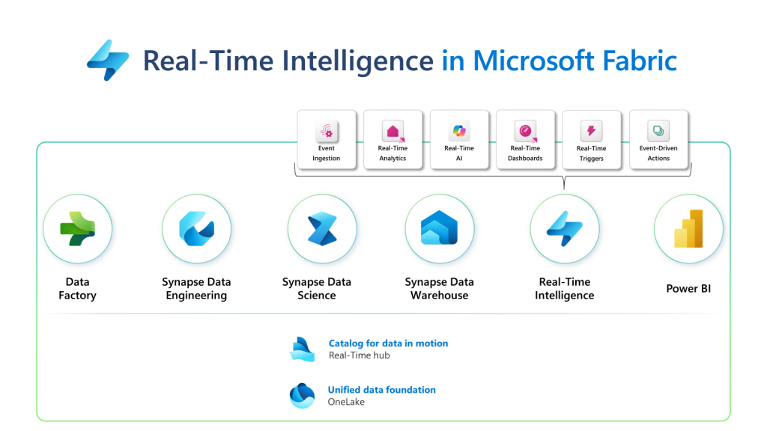
Microsoft Fabric
The data platform for the era of AI
Notes:
Data Activator is brand new to Fabric. We released it to public preview in October
It’s part of MS Fabric.
Microsoft Fabric is an all-in-one analytics solution for enterprises that covers everything from data movement to data science, Real-Time Analytics, and business intelligence. It offers a comprehensive suite of services, including data lake, data engineering, and data integration, all in one place. We call these services “experiences”.
Upon its release, Data Activator became the seventh Fabric experience.
Available now, by selecting it from the experience switcher in your Fabric homepage

Slide 5


Slide 6

Driving actions from your data
Data
Activator
Monitor
Detect
Act
Notes:
Your data is only valuable if you can drive actions from it.
Data Activator is all about driving actions from your data
What we’re especially interested in with DA is situations where you have to monitor a bunch of business objects, detect actionable conditions in those objects, then act on the conditions.
This is a common pattern that applies across many business domains

Slide 7
Examples of Monitor, Detect, and Act
Finance dept:
Customer invoices tracked, when they go overdue, Notify Account Manager to request payment
Manufacturing Co:
Uses integrated 3rd party shipper updates, when any are delayed shipments, update recipient and submit for refund/discount from shipper.
Construction Co:
Track fleet vehicles’ tire pressure via IoT, When any tire has low pressure, Create a service alert for field
Speed
Notes:
Let me give you some examples
Perhaps the finance department wants to monitor invoices that they’ve issued to customers. If an invoice is overdue, they’d like the account manager who manages the relationship with that customer to contact the customer to request payment.
Consider a manufacturing company that sends goods from its factories to its customers. It uses 3rd-party shippers to send the goods to its customers. It wants to monitor the status of those shipments and if any of them are delayed, it wants to notify the customer proactively.
Finally, consider a construction company that manages fleets of vehicles. They want monitor the tire pressure using IoT sensors and detect if the tire pressure is low.
These are all real examples that we’ve seen in the field during our Data Activator private preview
And they all follow that monitor, detect, act pattern.

Slide 8
How do organizations drive actions from their data?
Notes:
And so the question is: how to organizations typically handle this type of case? How do they go about driving actions from their data?

Slide 9
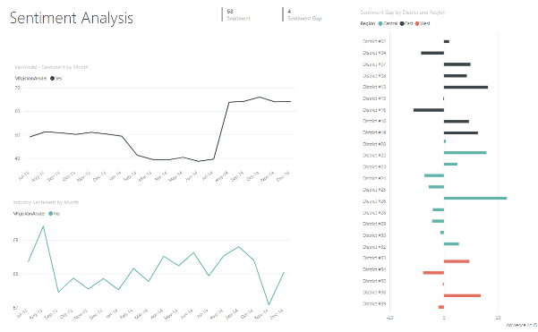
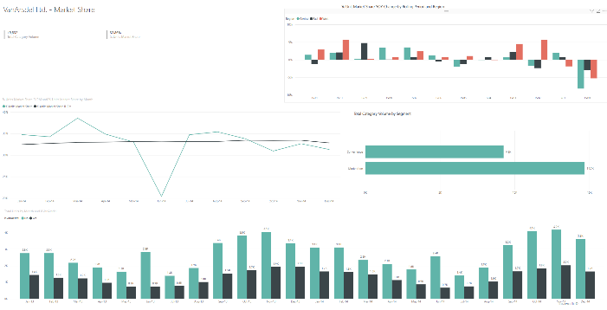
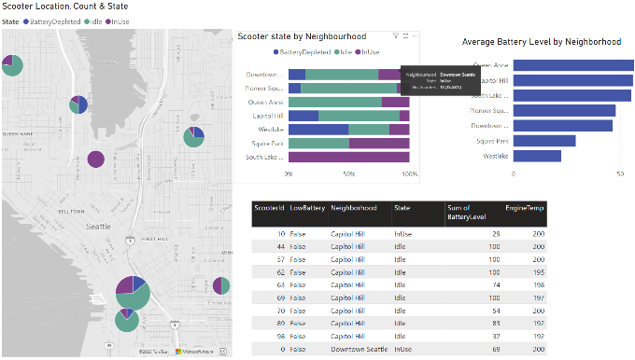
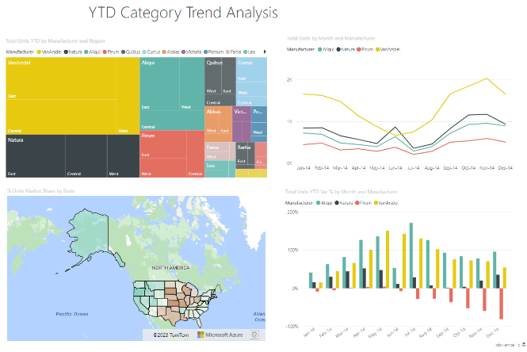
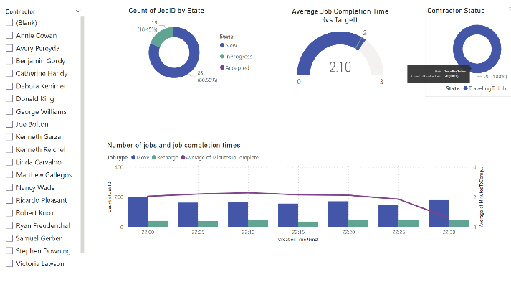
Usually, it is a manual process
Notes:
The answer is: it’s usually a manual process
The typical scenario is that you have a central data team who is tasked with making reports for the business
The reports get pushed out to the business
The report consumers monitor the reports continually and act as needed
The challenge is that the number of reports quickly multiplies
This creates a burden on the central team as the number of reports they need to maintain continually increases
And it creates a burden on report consumers, who need to monitor many reports to get their jobs done
Often people are too busy to check on the reports, or they just forget.
Sometimes the report consumers don’t even know the reports exist
The result is that things fall through the cracks.

Slide 10




What if we could automate it?
Manual
Code
No-code
Staff diverted
Hard to drive engagement
Hard to scale
Lack of agility
Expensive
Hard for IT to scale
Empowered experts
Fast iteration
Every department
Notes:
So that’s the challenge with manual monitoring. It is hard to scale and very time consuming.
What if we could automate it?
Think about that example with the truck tire pressure.
Wouldn’t it be nice if we could just send an automatic alert to the relevant mechanic to warn them that they need to inflate the tire?
The challenge with that is that the rules quickly get complicated
The right tire pressure depends on the make and model of the truck
If the pressure is at zero that’s a very different matter to the pressure being just below the correct pressure
And which mechanic do you notify? It will depend on where the truck is
So all these rules need to get encoded into the alert logic
And that has typically required writing code in some form
It might just be a SQL query but it’s code nonetheless
And then you get all the challenges with writing code
You have to write a spec for the technical team
When the rules change, you have to rewrite the code
So it often turns out to be impractical.
What we need is some way to get to no-code alerts
We need to empower that truck mechanic to define the alert logic themselves, without having to write code
We want to empower the experts who know what rules to look for to create the alerts themselves.

Slide 11



What is missing today?
SYSTEMS OF
INTELLIGENCE
SYSTEM OF
DETECTION
SYSTEMS OF
ACTION
?
Notes:
So how could we achieve this?
Here’s what we think is needed.
Think about all your databases, data warehouses, reports, streaming data. We can class these as systems of intelligence.
And think about the systems where you drive actions from these systems. These could be email and teams as well as ticketing systems and line of business applications. We can class these as systems of action.
What we think is needed is a dedicated system that we call a system of detection. A system of detection can connect to all of your systems of intelligence, automatically detect anomalies that require action, then drive actions in your systems of action.

Slide 12


Introducing: Data Activator
SYSTEMS OF
INTELLIGENCE
SYSTEMS OF
ACTION
DATA ACTIVATOR
BUSINESS ANALYST
CLOSE THE LOOP
Notes:
And that’s what Data Activator is.
It’s a system of detection that is targeted specifically at the business analyst.
It lets the business analyst define what anomalies and rules to look for, and what actions to take in your systems of action.
We want to empower the business expert, who knows what rules to implement, to define these rules themselves.

Slide 13




Trigger actions on all your data, from one place
Power BI
Teams
Data Activator
Eventstreams
Outlook
No-code user experiences
OneLake
Power Automate
…
Models
Rules
Triggers
…
Real-time stream processing
…
Notes:
This is how it works
Data activator is a single place in Microsoft Fabric that lets you detect actionable conditions on any of your Fabric data.
It can connect to multiple data sources within Microsoft Fabric.
As of today it can connect to Power BI datasets, and streaming data in Fabric EventStream.
It then allows the business analyst to define rules for acting on that data, in a no-code way.
Then, it connects to your systems of action to drive actions in those systems.
It can drive actions in email and Teams
It can also trigger flows in Power Automate, so that you can connect to any of the connector systems that Power Automate supports.

Slide 14

Demo Scenario: London Bicycle Hire
Use real-time data from TfL docking station API
Monitor 800 docking stations across London
Alert if docking station has too few bikes, or too many
Notes:
OK. So it’s time for a demo.
The scenario I’m using for this demo involves monitoring bicycles for hire in London, which is where I live.
In London, there are 800 or so bicycle docking stations like this one you can see here, where you can collect a bicycle for hire.
Transport for London, which operates the service, has an open API which lets you monitor in real time how many bikes are available in each docking station. So we’re going to connect to that API.
And we’re going to build up some alerts to warn us if any of the docking stations don’t have enough bikes available.

Slide 15
What we just did:
Connected to the bicycle API
Made a trigger with complex logic:
“Alert me if the number of bicycles in any docking station in Belgravia becomes less than 5, and remains less than 5 for at least an hour”
Created a custom Teams message
… without writing any code

Slide 16
What we just did:
Created an alert from a Power BI report visual
Set the condition to:
“Alert if the occupancy of any docking station in Knightsbridge is below 20% or above 80%”
Set the alert recipient to another person

Slide 17

Data Activator + Power Automate
Data Activator Triggers Power Automate
Power Automate Drive actions
How it works:
Create a custom action, connect to a flow
Re-use the custom action across multiple triggers

Slide 18
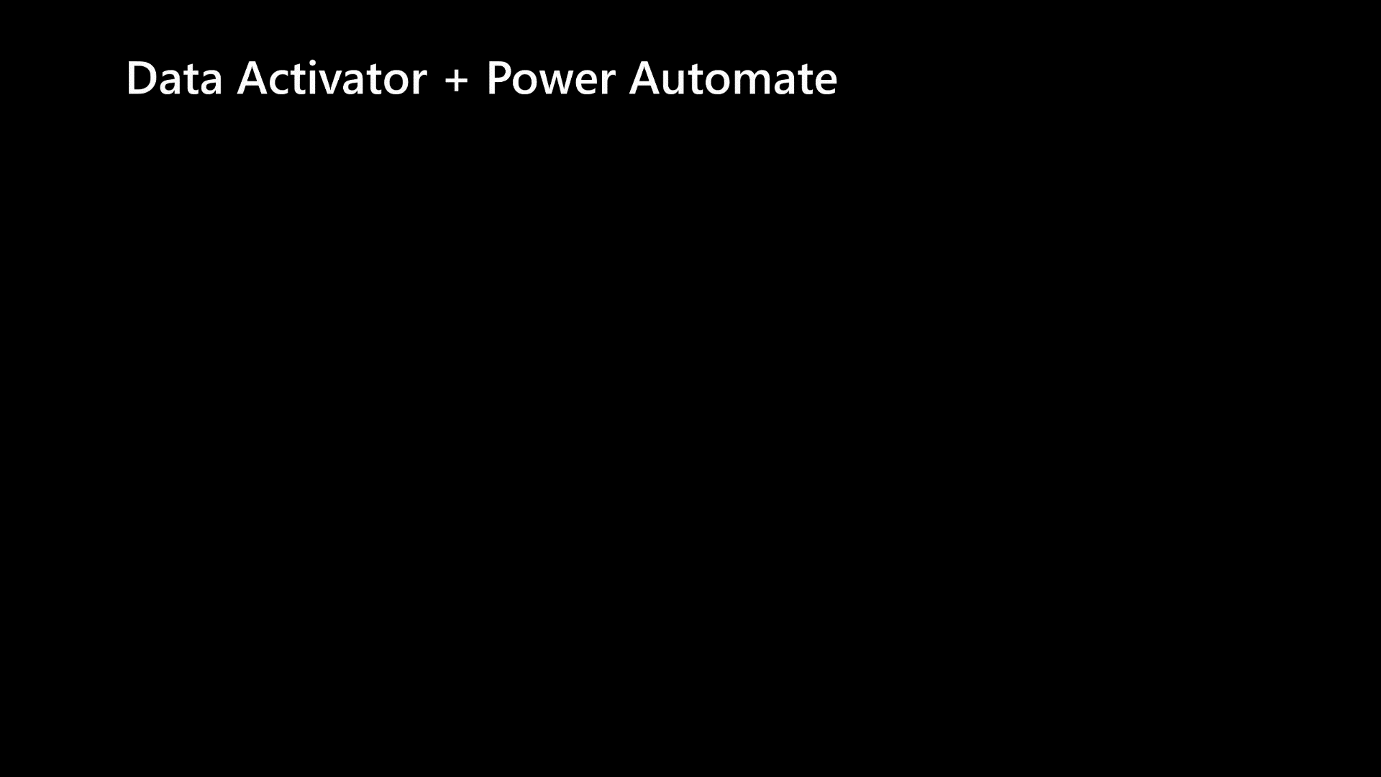

Slide 19
What we just did:
Created a reusable custom action
Connected the action to Power Automate
Called our new action item from a trigger and added actions to a Microsoft TODO list
Notes:
So, to recap:
We saw how with Custom Actions in DA, you can create reusable action templates that can drive actions in any of the hundreds of action systems that PA supports
We created a custom action that adds items to a Microsoft TODO list and called it from a Power Automate trigger.

Slide 20
Key Points
Drive automatic actions from your data
Define complex alert conditions without writing code
Connect to EventStreams & Power BI
Drive actions in email, Teams, and from Power Automate flows
Notes:
That concludes the demo so let me finish up by summarizing the key points that we covered today.
We talked about driving actions from data and that “monitor, detect, act” pattern that occurs across many business domains. And we talked about how this process is hard to scale up though manual monitoring, which drives a need for automation.
[NEXT]
We introduced Data Activator, which lets you define complex trigger conditions on your data, without writing code. Data Activator empowers the non-technical business analyst define the actionable conditions important to the business.
[NEXT]
Next we delved into driving actions from two Fabric data sources. First we drove actions from real-time streaming data in EventStreams, then created some triggers from within a Power BI report.
[NEXT]
Finally we looked at the range of action systems that Data Activator supports. We saw how it has native support for Teams and Email, and how it can trigger actions through Power Automate flows, giving you access to any of the hundreds of actions available through Power Automate.

Slide 21
Get started with Data Activator!
Available now in Fabric
User guide: aka.ms/dataActivatorDocs

Slide 22
Notes:
That concludes the session.
Thanks very much for joining today!

