Slide 2
Spar Kjøp D365 Journey
26.11.2024
Notes:
|

Slide 3
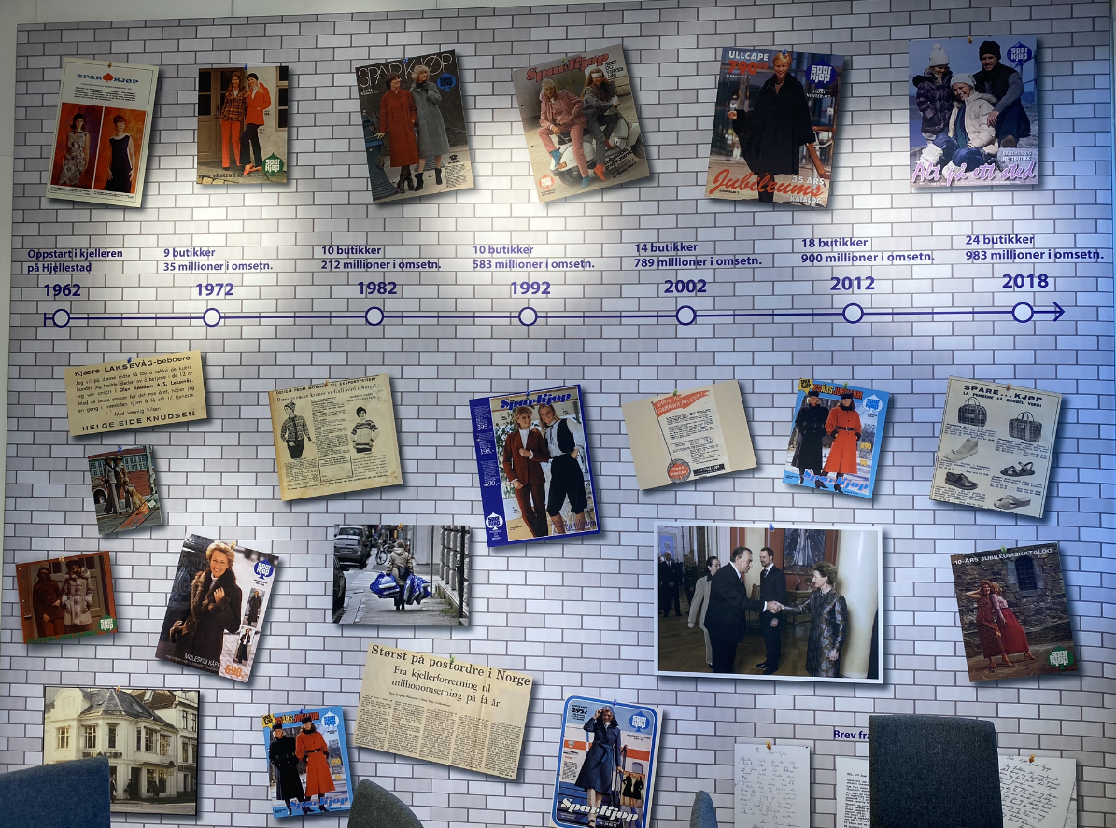
Who is Spar Kjøp?
Family-owned Business since 1962 with 500 employees (330 FTE)
Expected turnover in 2024: 1 billion in retail
Assortment: 30.000 articles
Main markets we are focusing on are yarn, women’s clothing, men’s clothing, children's wear, baby essentials, cosmetics, interiors and home textiles
24 stores and online shopping
Was traditionally a mail order business.
with marketing through catalogues
Transformation towards online shopping and brick and mortar stores during the last 20 years
Has been through a digitalization journey and modernization process on our digital platform site

Slide 4
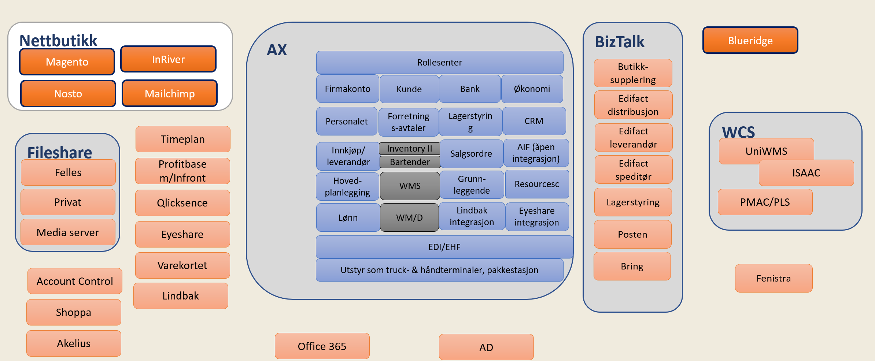
Spar Kjøp general IT for ERP / WMS before the transformation
Using Dynamics AX / Axapta since 2001 as ERP system
Complex architectural landscape
«many processes – had their separate system»
Challenging to integrate
High cost of maintaining
Technical debt was becoming a big factor
Depending an individual knowledge
Caused by extensive customization

Slide 5
Change management has been postponed
Change management requires focus
Market situations (both up and down)
General maturity
Technology
Organization
Security on the investment (ROI)

Slide 6
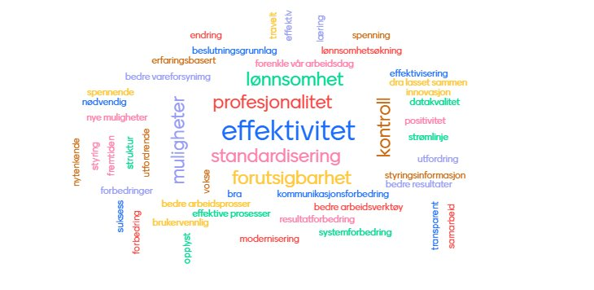
Our most important focus areas on our journey
Width involvement (to insure ownership within the organization)
What was important?
Think Spar Kjøp first
Standard processes throw out the whole organization
Master data management
Data availability
Reporting and analyzing
Automation of relevant processes

Slide 7
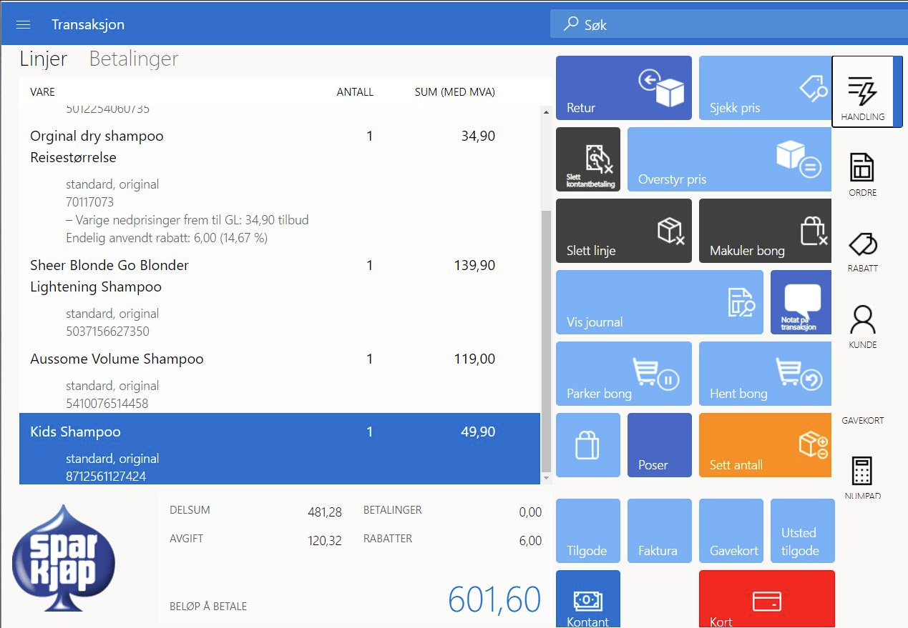
Our Cloud journey over the last 4 years
Moved our online store to the cloud
Preliminary project where we split out WMS from ERP
Live with Dynamics 365 Finance & Supply Chain inclusive Store commerce
Several applications have been moved to the cloud
Cloud-first strategies
SaaS
First Standard, then ISV solutions before any customization
Best of suite instead of best of breed where appropriate
Example: Microsoft Commerce (POS) in store

Slide 8
What did we achieve?
A more scalable solution
Application Lifecycle Management
Governance
Facilitates continuous improvements and updates
Support for omnichannel
Support for B2B
New integrated payment solutions
Fewer customizations
Improved control over master data
Better process support across the organization

Slide 9
Some advice on the way
Make a plan and stick to it!
Focus on master data and data quality
Do not underestimate the importance of training employees to understand new processes and ways of working
Allocate sufficient time for testing and include robust test scenarios
The solution must be able to adapt to developments in your industry (e.g., new/more payment solutions)
Consider phased implementation and stick to the agreed timeline

Slide 10
hhhh
Spar Kjøp D365 Nå (5 min)

Slide 11
Thank you
Notes:
|

