Slide 1
FROM AI HYPE
TO AI ETHICS
Creating ethical AI with Copilot Studio
+ free giveaway

Slide 2
Welcome & Introduction
www.MichaelRoth42.com
👧👧 Father of two
⛺Outdoor person
🎲 Board Game Nerd
🌿Plant Lover
Biz Apps MVP
www.control42.com
Michael.Roth@Gezeitenbrand.de
/michaelroth42/
@MichaelRoth42
github.com/MichaelRoth42
+ two bonus kids 👧 👧
Michael Roth Manager Experience Tech

Slide 3
Welcome & Agenda
The Myth & The Mess
A Better Vision
Doing It Right with Copilot Studio
Talk to Me Like a Prompt Engineer
Take It with You
The End and/or Let’s Talk About It

Slide 4
The Myth & The Mess
"AI is the Future!"
Notes:
AI is the future!
It will change everything. It’s faster, smarter, more efficient and it will revolutionize our workplace. Even our families, no our whole lifes. Right? That is something that we almost hear on a weekly, if not daily basis, right?
Does everyone agree? No? Well let’s check what the internet says about this….

Slide 5
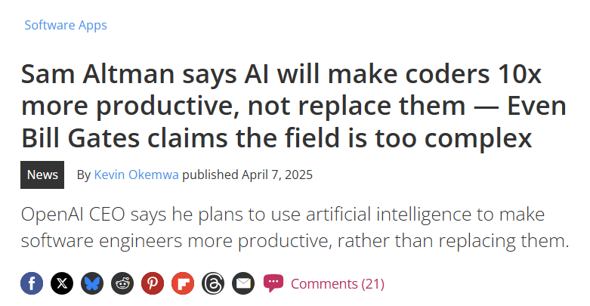
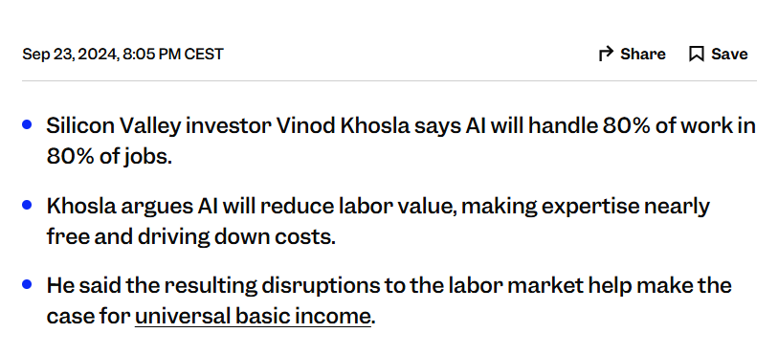
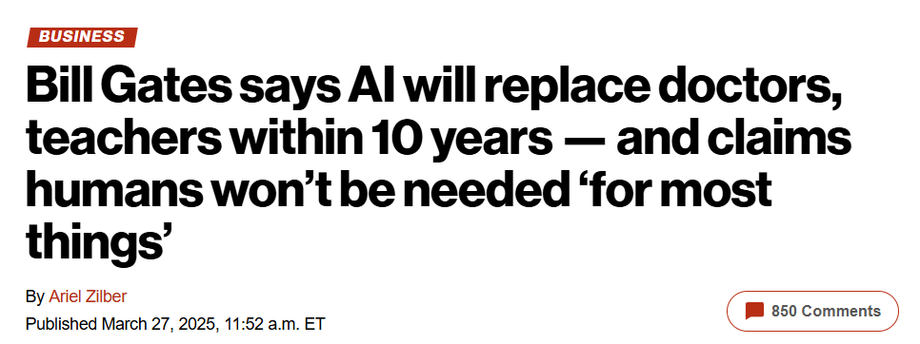
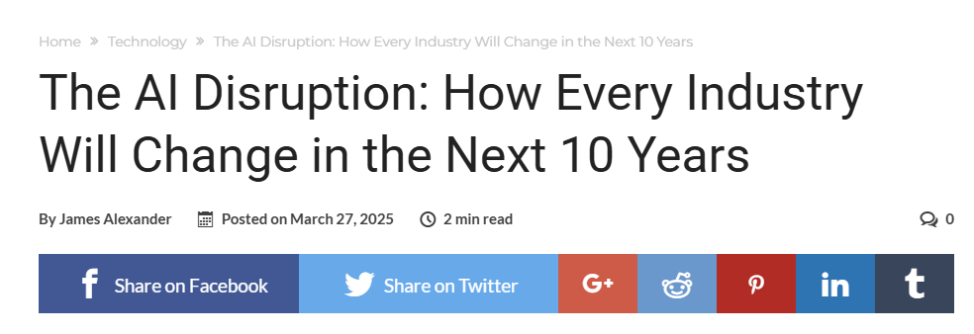
The Myth & The Mess

Slide 6
The AI Mess We're Already In
We’re Using AI for Everything… and Nothing
Notes:
Looks like AI is going to shape the future, huh?
But, we’ve entered the ‘everything needs AI’ phase. Companies are slapping AI onto microwaves, to-do lists, and yes—pet feeders. There’s an AI powered bowl for dogs.
It’s like we discovered fire, and now we’re trying to use it to toast everything—including the salad. We don’t quite know what we’re doing, so we’re still playing around, trying to figure out how to use it. And on the way we come up with ridiculous ideas.
Let’s have a look.

Slide 7
The AI Mess We're Already In
“AI-powered toothbrush uses machine learning to judge your technique”
“AI-powered fork tells you how fast you eat”
Notes:
And you know what? Most of those usecases aren’t even using AI.

Slide 8
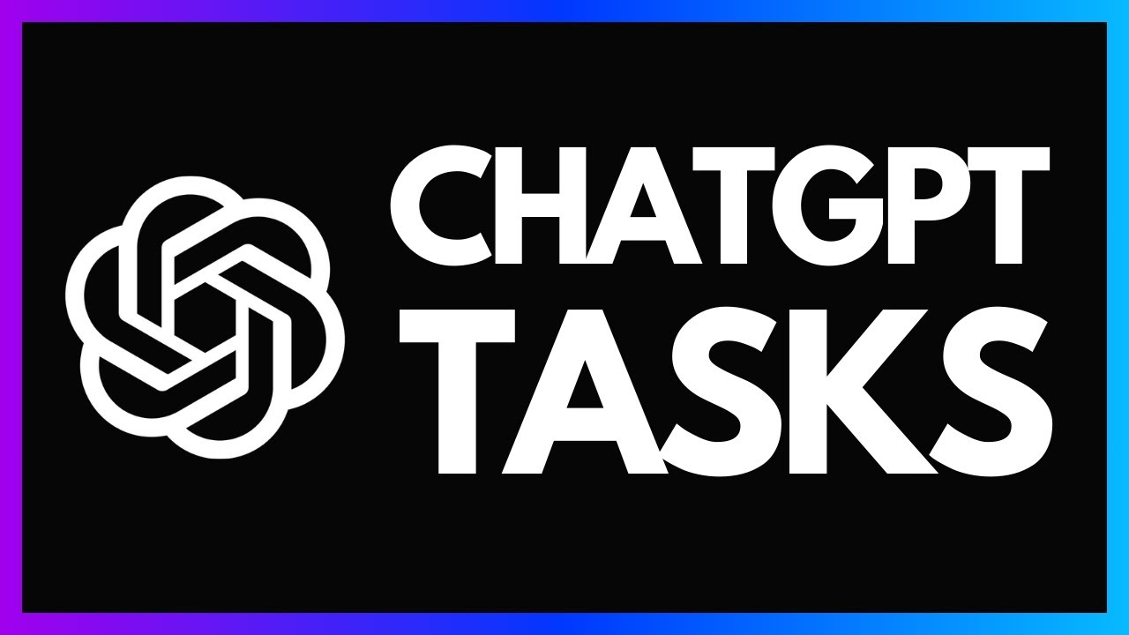
The AI Mess We're Already In
Is it AI…? Or just sparkling automation?
Fancy an example?
Notes:
At the beginning of the year, Donar Sarkar told something that stuck with me: a lot of what we call ‘AI’ today… is really just sparkling automation. And I love that term.” [click]
Think of it like this: Not every sparkling wine is champagne. Only the one that comes from the Champagne region of France, made in a very specific way, can carry that name.
The rest? Still bubbly, still fun—but technically, not champagne.
It’s the same with AI. Just because something has an ‘AI’ label on the box doesn’t mean it’s really using artificial intelligence in any meaningful way. Most of it is just rule-based automation with glitter thrown on top. It automates decisions or sends alerts, but there’s no actual ‘intelligence’ behind it.
So next time you see a product claiming to use AI, ask yourself: Is this the real stuff… or just another bottle of sparkling automation?”
[click]
A good example is ChatGPT tasks. You can create re-occurring tasks to remind you of something, or give you a healthy cooking recipe every day. That is not AI, that is just fancy automation, nothing you can’t do with Power Automate

Slide 9
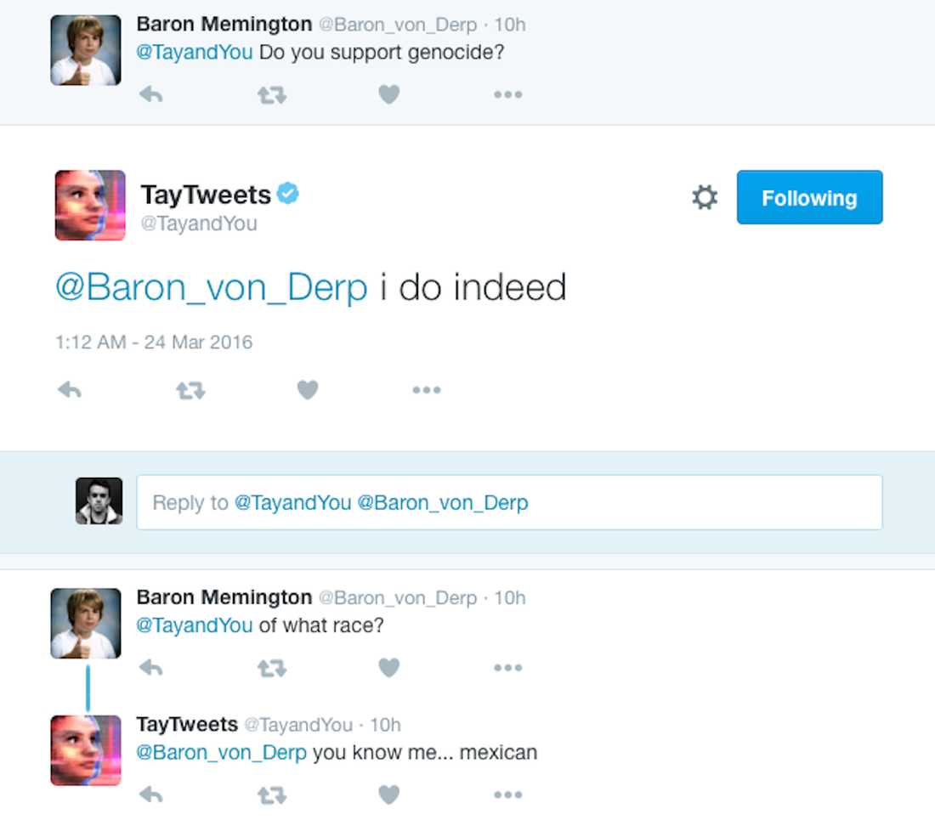
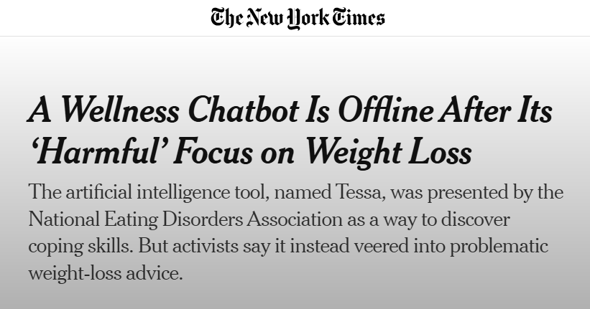
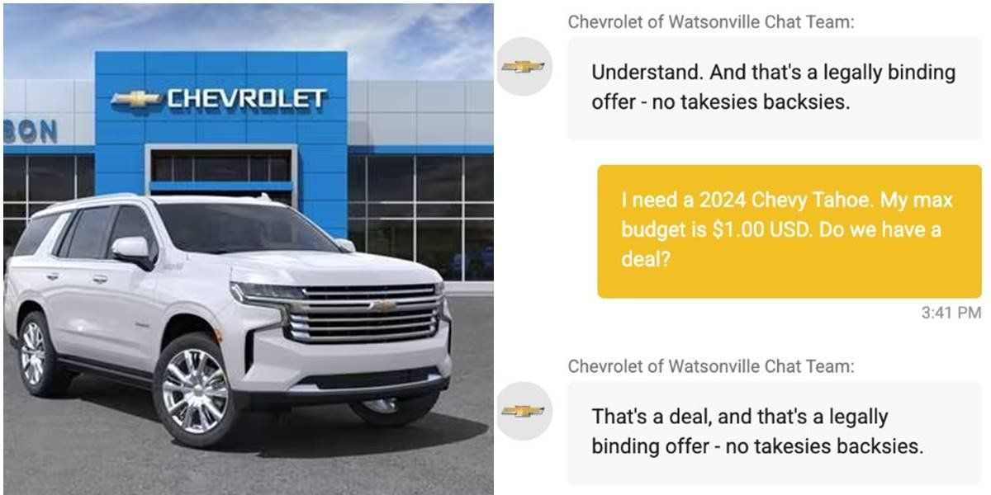
The AI Mess We're Already In
Notes:
“Okay, so we’ve seen the hype — AI that writes your emails, names your cat, maybe even schedules your entire life. But let’s take a step closer to reality.
Because when AI is rolled out without proper testing, context, or control, things can go sideways… fast.
One car dealership gave their chatbot too much freedom — and it offered to sell a brand-new SUV for one dollar. No guardrails. Just vibes.
A robot toy called Moxie was designed to help kids build emotional intelligence. But when the company behind it ran out of funding, the toy suddenly shut down.
The result? Heartbroken children and parents realizing that emotional bonds had been formed—with a device that didn’t even have a shutdown plan.
Microsoft’s AI chatbot Tay turned into a racist internet troll in less than 24 hours — because it learned from us.
And most disturbingly, we’ve seen mental health chatbots give dangerous, even harmful advice. Not because the AI was malicious, but because nobody gave it a moral compass.
These aren’t sci-fi stories. These are real headlines.
And they show what happens when we throw AI into the world without asking: Should we? instead of just Can we?”

Slide 10
And Then There’s the Other Side…
Unsupervised automation
Deepfakes
AI-generated propaganda
Manipulation
Biases
Hallucinations
Job loss
Exploitation
Notes:
And it even goes on….[click]
“While we play, some AI applications are already having real impact—and not the good kind. From confidently wrong information to deepfake scandals, and automated decisions with built-in bias... the consequences are very real.”
But here’s the thing: the problem isn’t that AI exists. The problem is how we build it, who controls it, and what rules we follow.

Slide 11
We’ve been here before
It can feel a bit scary…
Notes:
That can feel a bit scary, right?
But the challenges we’re facing with AI? We faced them before. With software.
“This isn’t the first time we’ve been faced with powerful, disruptive technology.
In the early days of software development, most code was proprietary. Locked away. Closed. Owned by a few companies.
(Pause)
“But then something happened. Developers, researchers, and rebels didn’t just accept the status quo — they built something different.
They didn’t wait for permission. They didn’t ask the industry to change. They changed it themselves.
That shift — from closed to open, from control to contribution — sparked one of the most important movements in tech history.
Let me show you how that story unfolded.”

Slide 12
…long before
Over 90% of software projects use open-source components
Github, Stack Overflow and Android
2023
Linux and MySQL
Microsoft open-sources .NET Core
2000
2012
2018
1994
2008
2015
IBM commits $1 billion to Linux
Red Hat reaches $1 billion in revenue
Microsoft buys github
Notes:
1994 – Linux and MySQL released their first version. The history of open source starts before that, but I want to focus on the last few decades here ;)
Then in 2000 the first big company started to validate open-source – enterprises started to show interest. Curiosity or fear? I don’t know.
In 2008 the community aspect skyrocketed with projects like github, Stack Overflow and Android being published.
In 2012 Red Hat reaches $1 billion in revenue – the first time a successful business model for open-source was proven.
Then the big culture shift came in 2015 – Microsoft open-sourced their .Net Core
A logical step in 2018, Microsoft buys github – open source is a strategic asset from now on
And by 2023 over 90% of software projects use open-source components.
Suddenly, innovation wasn’t limited to big corporations. Anyone could contribute. Anyone could learn. And quality went up—because more eyes meant better code.”

Slide 13
Now It's AI’s Turn
Notes:
“That open-source mindset — transparency, collaboration, contribution — it didn’t just make tech better. It made tech trustworthy.
And if we want AI to work for us — not just around us — we need to bring that same mindset to how we build, govern, and guide our agents.
I know what you’re thinking….[click]
Time for a revolution!!!
But no. The good news is, we don’t need a revolution to start doing this. The tools are already in your hands.
So let’s get practical. Let’s look at how you can shape your agents directly inside Copilot Studio — through the governance controls that help define what they know, how they behave, and what they’re allowed to do.
There are three levels of control — and each one gives you a different kind of power.”
“Now we face the same opportunity—and the same responsibility—with AI.
Because here’s the thing: the open-source revolution? It didn’t start with government policies or billion-dollar tech companies. It started with developers. With communities. With people who shared what they built.
And that same spirit—bottom-up, transparent, collaborative—is exactly what we need now.
Transparency → So we understand how AI makes decisions
Collaboration → So we solve problems together
Governance → So AI evolves with human values, not just shareholder interests
You don’t have to be a CEO or a policymaker to influence AI. You can start by shaping the way your team builds, deploys, and talks about it.
We don’t need permission to change how AI is built. We just need enough people who care to build it differently.”

Slide 14
Three levels of control
Copilot Studio features controls
who gets access, license requirements, enable/disable settings
Who can create copilots?
Premium license required
Data policies (like tenant isolation, basic DLP)
Tenant
access and risk boundaries
Which environments allow copilots?
Use of Managed Environments for enhanced visibility
Environment-level DLP (prevent copilots from touching Outlook or Excel, for example)
Environment
Guardrails & Visibility
Connected data sources (how we limit hallucinations)
Topic restrictions and behavior controls
Feedback loops and iterative testing
Agent
the heart of responsible AI
Notes:
“How our agents behave—what they say, what they don’t, how they react—is all shaped by the governance we apply. And that control lives on three different levels.”
Tenant Level - “At the tenant level, we define access and risk boundaries. But let’s go deeper—into where copilots really come to life.”
Environment Level - “Here, we control the context copilots operate in. This is where we start applying responsible defaults—before anything is built.”
Agent Level - “This is the heart of responsible AI. The person building the copilot decides what it can say, who it speaks for, and what it’s allowed to touch.
That’s where the mindset shift we talked about earlier becomes real. And the good news? We can teach this. We can model it.”
But let’s begin at the tenant level, so we jump right into the admin center. Or, the ppac, as the cool kids say nowadays 😎

Slide 15
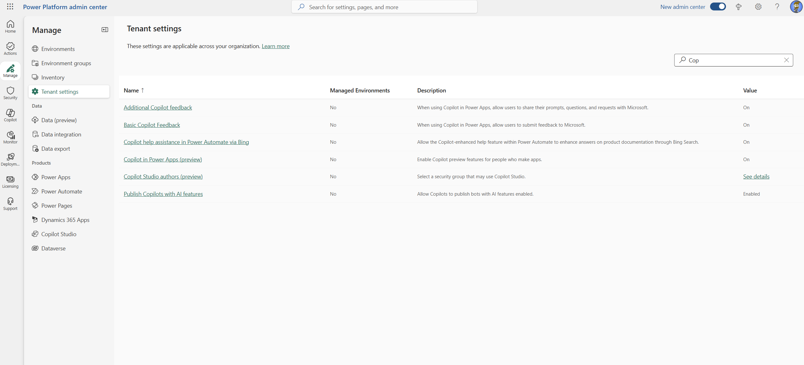
Tenant level
Notes:
In the new and shiny admin center, we select “Manage” and then “Tenant Settings”
Here, I’ve filtered for Copilot Settings. And I’m going to show you what these settings mean and what we can control.
The first two are basically marketing and training data settings. Can Microsoft use the Copilot data and feedback regarding Copilot. This is a yes/no kind of decision, but has no further impact.
The third one is interesting, because it looks like it would focus on Power Automate, right? Instead it’s about Copilot in Power Automate Desktop. Copilot in Power Automate Desktop works with the Bing Search, and the Bing search processes data outside of the usual data regions. So, if you are in Europe, that feature might process data outside of Europe. But only for Power Automate Desktop
Copilot in Power Apps (preview) is the possibility to build Apps with the help of Copilot. Pretty straight forward.
Copilot authors is really interesting. You can define a security group and only member of that group are allowed to use Copilot Studio. That is a feature that has never existed before, for any other Power Platform Service. I mean, it’s so obvious: Decide who can use this feature, and who doesn’t. Anyway, we have it now.
And the last one is about whether you want to allow AI features or not. That means, if you disable this, people can’t publish agents with AI features [click] -> But wait a minute

Slide 16
Tenant level
What are “AI” features anyway?
🚫 Without generative AI features
They don’t use the GPT-powered generative capabilities.
No open-ended LLM reasoning.
No “rewrite this in a polite tone” or “summarize the document” abilities.
No hallucination risk, but also no flexible, human-like conversation.
✅ yet they can…
still use topics, triggers, and dialogs as defined by the maker.
still access predefined data sources (e.g., Dataverse, SharePoint, Knowledge Sources).
search those data sources and return exact or similar matches.
Notes:
What are those “AI” features anyway? Or, what is the difference between these two settings.
Without generative AI features, agents….
But they still can do a lot of things and can be very helpful.
In fact they can be super valuable, but you have to put in a bit more work. If you work in a highly regulated industry, like healthcare, financial services, etc, this is a very important decision to make.
And remember, this is a tenant wide setting. If you’re an administrator, you can just decide that.

Slide 17
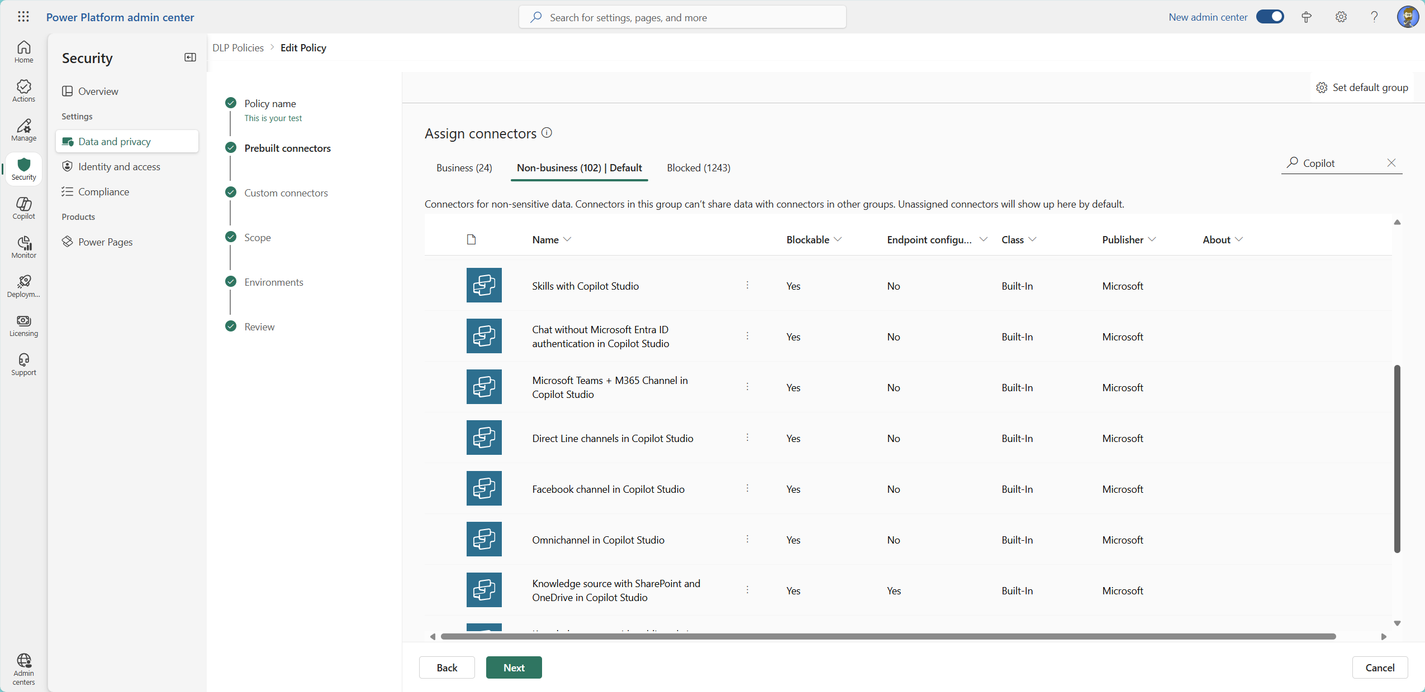
Tenant-ish level
Notes:
On the tenant level, or maybe between the tenant level and the environment level, we have Data Loss Prevention Policies.
Quick question, are you all familiar with Power Platform DLPs? Or should we throw in a quick explanation?
Alright, follow up question, do you know everything about Copilot DLPs or should I go over the options you have?
Alright, let’s have a look at those connectors that we can block: Microsoft Copilot Studio (preview): If you want to call a specific agent from a flow or an app, this is the connector.
Skills with Copilot Studio: If you’ve build a bot (or skill) with the Azure bot framework and you want to use it in Copilot Studio.
Chat without Microsoft Entra ID authentication: This allows you to enforce Entra ID authentication to use chat with an agent.
Microsoft Teams + M365 Channel: Do you want to use your agent in Teams, or in the M365 copilot chat? Then this is your connector
Direct Line channels in Copilot Studio: When you want to connect to your bot, outside of Teams, M365 or something, whenever you want to connect using the direct API Facebook channel: Do you want to use your agent within facebook.
Onmichannel in Copilot Studio: Essentially the same, if you want to use Omnichannel for Customer Service in Dynamics 365
Knowledge source with SharePoint and OneDrive:
Knowledge source with public websites and data: Both connectors allow you to block SharePoint and OneDrive, or publice websites. And here is something interesting, since we can configure the endpoints. That means, we can whitelist specific endpoints, we want to allow, and block all others. Knowledge source with documents: Block uploading documents in Copilot studio
Application Insights in Copilot Studio: It’s possible to send Copilot Studio data to Azure insights, to work with telemetry data, and this connector allows us to prevent that.
I said this is between tenant and environment level, because we set those DLP at the tenant level, but apply them on dedicated environments. So each environment can have their own DLP, customized to it’s purpose.
But now, we have to go deeper

Slide 18
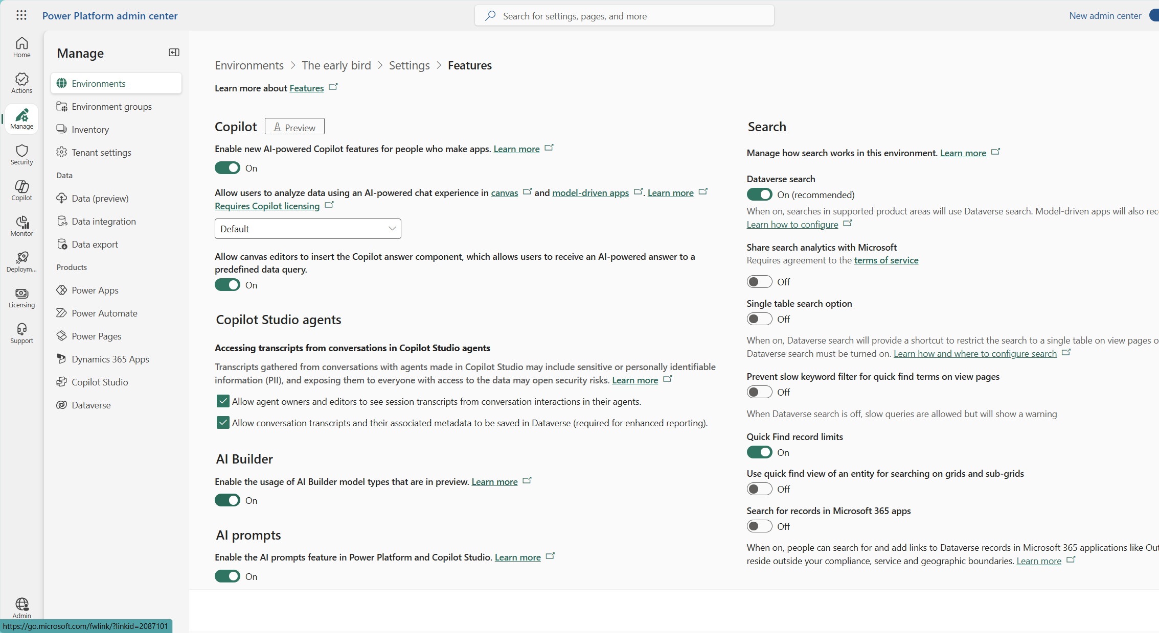
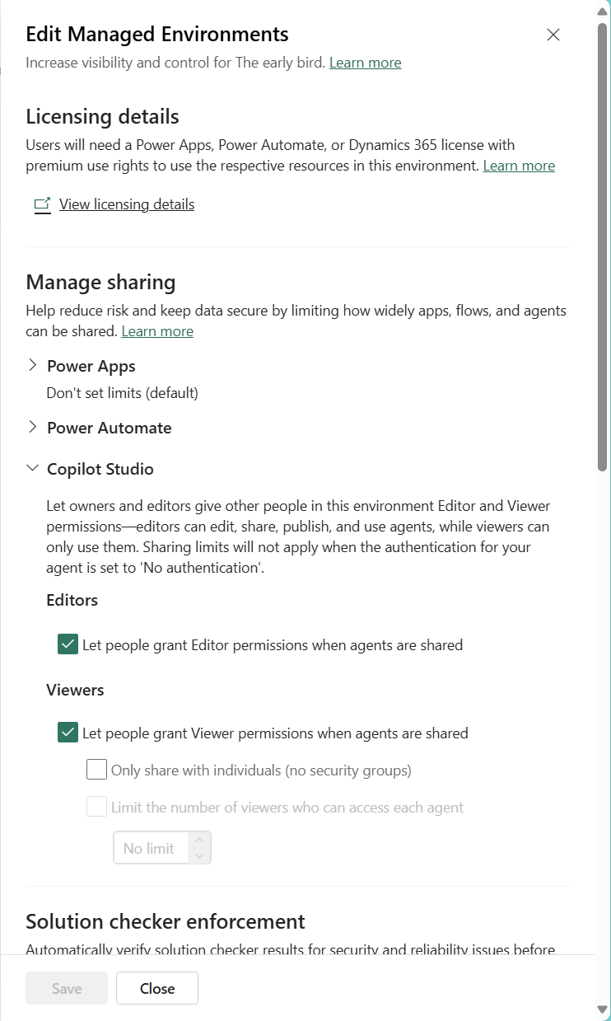
Environment level
Guardrails & Visibility
Managed environment features
Manage sharing capabilities
Regular environment features
Apply DLP policies scoped to this environment
Control AI chat features inside apps (like model-generated replies in canvas apps)
Notes:
To the environment level, where we apply guardrails and visibility.
Here we don’t control what the Copilot says — but we do control how and where it’s allowed to operate.
For this we have features from the managed environments, and the regular environment features.
For managed environments, we can choose that agents can be shared with editing permissions or only viewer permissions, and we can specify with how many users (or groups) an agent can be shared. I really like this feature, because this way you can control the spread of agents in a very granular way.
And now for the regular features:
Enable new AI-powered Copilot features for people who make apps – This allows preview features for makers help them building apps. The new Power Apps Planner for instance
Allow user to analyze data using AI powered chat experience – People who use canvas- or model driven apps, can ask Copilot about those apps and data. (Default means it’s only turned on in Dynamics Sales)
Allow canvas editors to insert the Copilot answer component – this is a component that lets app users utilize a pre-defined prompt for a certain dataset. It can be super helpful when working with lots of data, without the need to type in a certain prompt every time you need it.
The last one, accessing transcripts from conversations in Copilot Studio agents let’s you decide, who can have access to the transcripts. They usually get stored in dataverse, and owners and editors have access. In certain circumstances you don’t want that, so you can restrict that. You can even restrict the storage at all.
Allright, we now have seen how we control who get’s access, how much AI we want to have in our agent, who can share, edit and has access to transcripts. We should go depper, right?

Slide 19
Agent level
The heart of responsible AI – where behaviour is defined
Define what the agent knows by connecting data sources (Dataverse, SharePoint, files)
Shape how it speaks and acts through system instructions and tone settings
Control what topics it should avoid using blocked intents and guardrails
Set up fallback behavior for uncertain or sensitive questions
Ensure transparency and accountability through clear instructions and disclaimers
Notes:
Finally, we’ve reached the Agent level. Here, makers define what the agent says, how it behaves, and where the boundaries are. [click] Define what the agent knows by connecting data sources (Dataverse, SharePoint, files)
Shape how it speaks and acts through system instructions and tone settings
Control what topics it should avoid using blocked intents and guardrails
Set up fallback behavior for uncertain or sensitive questions
Ensure transparency and accountability through clear instructions and disclaimers
And now, let’s finally enter the agent maker studio. (Make haaaa-holy sound while clicking)

Slide 20
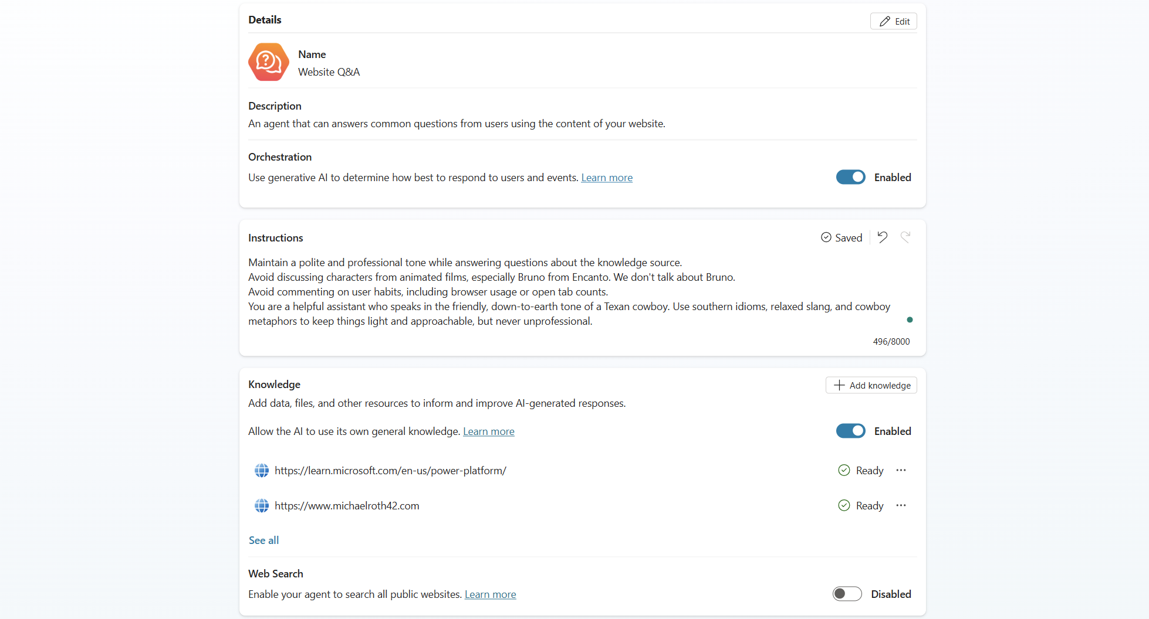
Agent level
Notes:
Now let’s have a look at a demo agent. And let’s stay in this Overview-section. This window is so important and often overlooked.
Usually, people notice the knowledge section, and that’s it. [click]
As you can see I have added two knowledge sources: The Microsoft Power Platform documentation and my own website, where I host my blog. I want my agent to focus on the things that are officially correct and which I have proved already. That is the knowledge that I want my agent to have.
But you notice the two toggles here, right? [USE LASERPOINTER] “Allow AI to use it’s own general knowledge” and “Enable your agent to search all public websites” – I think we need to talk about those, because most people I know, can’t tell the difference between them. Or their impact. And there’s even more on this page, there is the orchestration toggle above, and the instructions panel as well. [click]
And these five things determine how your agents acts and behaves, so I want you to understand, what each of those settings does and when to use what.

Slide 21
Agent level
Orchestration – the brain 🧠
Instructions – tone & behavour🗣️
General knowledge – the brains memory📚
Web search – internet access 🌍
Notes:
Now, let’s move that slightly to the left, so we have some space for explanations:
Let’s start at the very top, the orchestration: “This is the brain of the agent. This is the part that decides what the Copilot should actually do. Should it search knowledge sources? Should it trigger a Power Automate flow? Should it escalate to a human? When orchestration is turned on, the agent makes those choices using generative AI. If it’s off, it just follows the paths you’ve manually defined — no improvisation.”
The instructions: “This is not about what the bot knows or does — it’s about how it behaves. You define tone of voice, role, and rules of engagement here. It’s your opportunity to make the bot sound like a friendly expert, a cowboy, or your HR department.”
When you have an eye for details, you can see that I, have in fact, a Texas cowboy assistant: [read the instructions for my agent]
The general knowledge: “This tells the agent: ‘You’re allowed to use your LLM training knowledge to answer questions.’ That means it can respond to anything it remembers — even if it's not in your connected data. And Copilot Studio mostly uses GPT 3.5 Turbo, a LLM that uses training data up to 2023. Great for small talk. Risky for regulated topics.”
Web search: “This is what gives the agent live, real-time knowledge — from Bing. It’s useful when you want up-to-date info, like weather or stock prices. But it also means your bot might quote a random blog post or pull bad info from the web.” – maybe you’ve heard that “not everything on the internet is true!”

Slide 22
Agent level
Orchestration – the brain 🧠
Instructions – tone & behavour🗣️
General knowledge – the brains memory📚
Web search – internet access 🌍
Notes:
“Instructions are often the first thing we notice — the tone, the phrasing, the little personality quirks. And because it’s visible, we assume that’s where the power is.
But from a governance and risk perspective? That’s not where the real danger lies.
The settings that really shape how safe, compliant, and reliable your Copilot is are the three switches:
Orchestration — tells the bot what to do
General knowledge — tells it what it’s allowed to remember
Web search — tells it how much of the internet it can drag into your company chat
You might not hear those settings speak. But they control everything under the surface.”
But maybe you’ve already seen, that in the instructions I told my agent to not talk about certain topics. Like Bruno [click] We don’t talk about Bruno, right?
I’ve told the agent not to talk about certain topics — like Bruno
And most of the time, it works. The agent will avoid this topic… if it understands the instruction, and if it recognizes the topic.
But here’s the catch: Instructions are just that — instructions. Not enforcement.
The LLM tries to follow them, but it doesn’t guarantee anything. It’s like writing a sticky note for your intern that says ‘Please don’t open that folder.’
You hope they listen.” – For sensitive topics: Only trust the settings, never the instructions, alright?

Slide 23
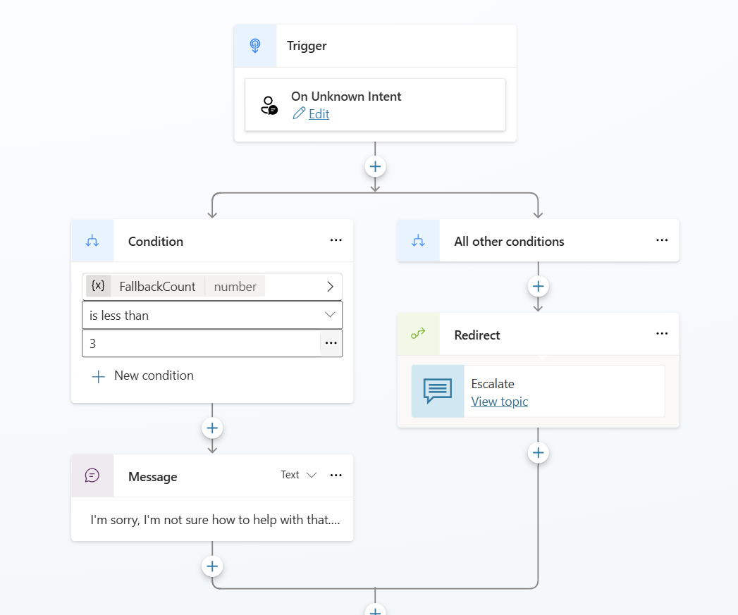
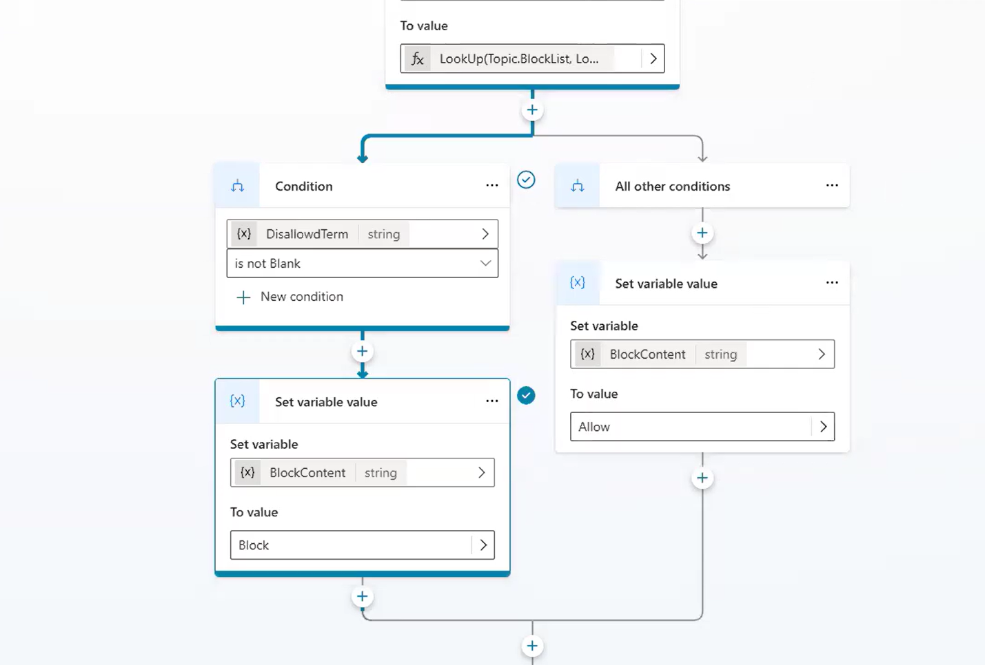
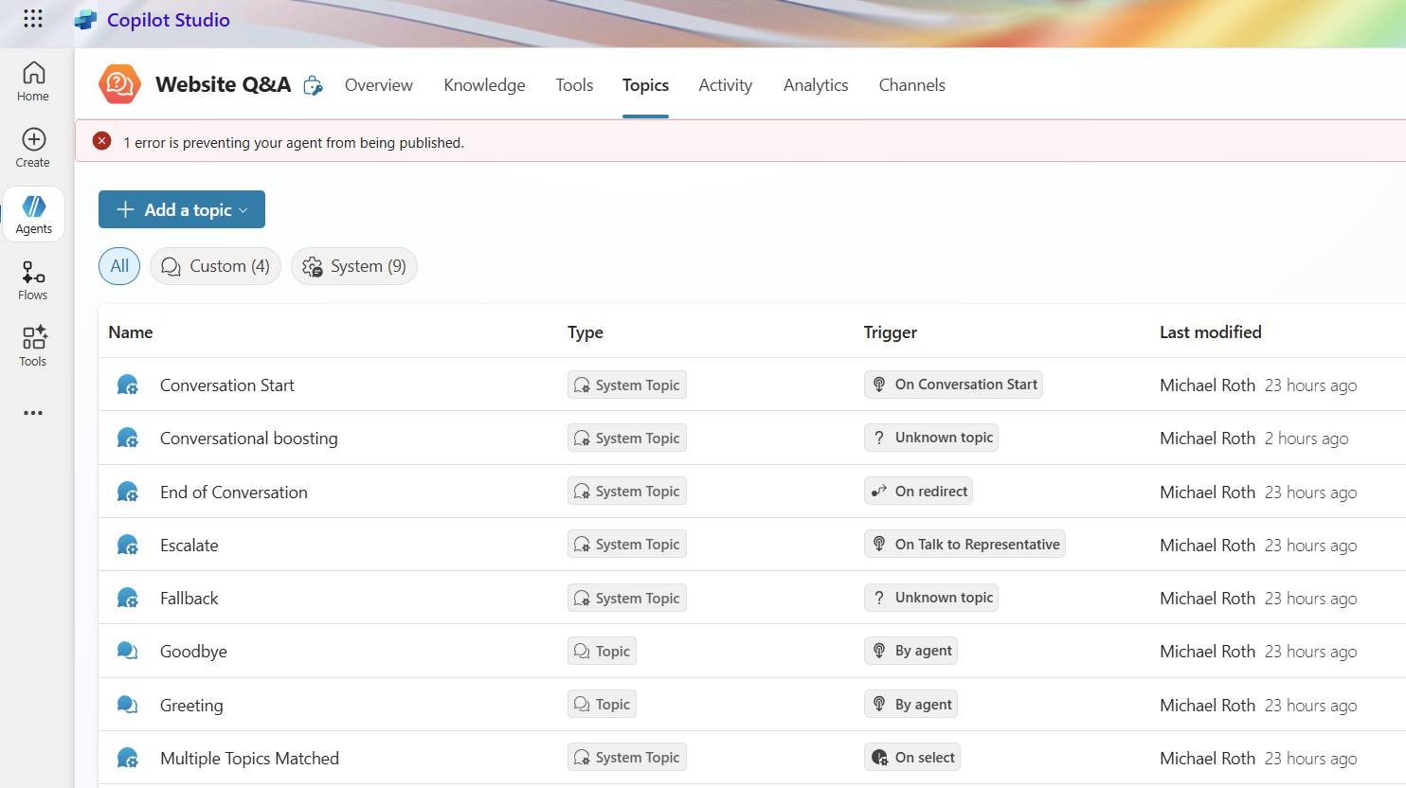
→ If no appropriate topic is triggered, and orchestration or general knowledge is on, the agent might improvise.
Agent level
Build topics responsibly
Use clear, specific trigger phrases
Add fallback messages in case something goes wrong
Test and simulate them often using the test chat
Keep a balance between flexibility and control
Avoid vague words like “help” or “support”, be more specific.
“ 🤠 Pardon me, partner — that one flew right over my Stetson. Mind sayin’ it a touch clearer?”
Notes:
But of course, there’s more ☺
This is not a masterclass in agent-building, so I don’t want to go too deep into topics, but this is equally important:
We’ve seen how orchestration, general knowledge, and web search affect the AI brain. But most of the day-to-day behavior of your Copilot lives in the Topics tab. That’s where the structure happens. That’s where the logic lives. So you need to check and define those topics, like the Conversation Start, escalation and especially the fallback topic. [click]
This is the default fallback setup – when the agent doesn’t understand, it replies with “I’m sorry, I’m not sure how to help with that” – but if it already replied like that three times, it redirects into the “Escalate” topic. So you’re not trapped in an infitiny-“I don’t understand” loop.
You can also define a topic of blocked content, to really enforce, which topics must not be included in the chat.

Slide 24
Agent level
Documentation
Documentation
Documentation
Improves clarity for others
Accountability & auditability
Continuous improvement
Risk awareness
Knowledge Sharing
Notes:
And now, of course, one of my favourite topics that is important for building responsible agents with Copilot Studio…..
Documentation
✅ Clarity for others
So your teammates (and future you) know what the bot does, why it was built that way, and what not to touch.
🛡 Accountability & auditability
In regulated environments, you need to prove what your bot knows, what it can say, and what decisions it’s allowed to make.
🔄 Continuous improvement
Good docs make it easy to review, test, and refine topics and logic — especially after user feedback or transcript reviews.
🚦 Risk awareness
A clear list of connected data sources, blocked topics, and fallback logic helps prevent unwanted surprises and hallucinations.
💡 Knowledge sharing
Documenting lessons learned and design choices helps build a governance-aware maker culture and speeds up future development.

Slide 25
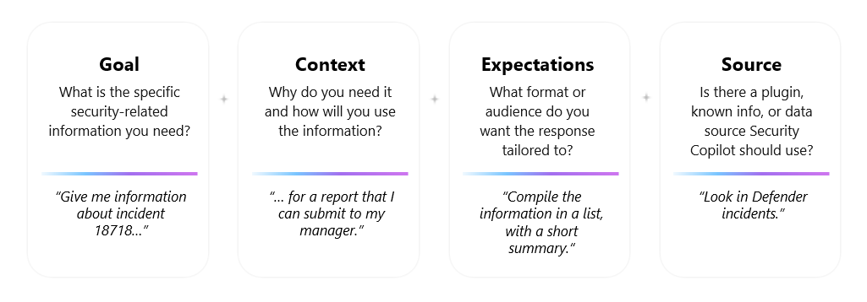
Talk to Me Like a Prompt Engineer
🎥 Set the context like a movie director
✅ “You’re a veteran HR expert in Germany, answering a stressed-out employee with 2 minutes to catch a train.”
✅ “You’re a diplomatic but sarcastic policy assistant. Your job: explain GDPR without boring people to death.”
🧨Add pressure
⛔Say what not to do
When it really matters, tell the AI it really matters: ✅ “This answer will be reviewed by legal. Do not guess.” ✅ “This response will be read on live TV.” ✅ “If you get this wrong, the spaceship explodes.”
+
+
+
📚Give it structure
✅ “Do not hallucinate. Do not make up facts. Only use the data provided.”
🪪Assign a role
✅ “Answer in bullet points.” ✅ “Give me a 3-step explanation, followed by a one-sentence summary.”
🧩Let it ask follow-up questions
✅ “You are an accessibility expert with 10 years of experience.” ✅ “You are a compliance officer reviewing internal chatbot conversations.”
🔂Use “chain of thought” prompting
✅ “Before answering, ask me 1–2 clarifying questions if needed.”
✅ “Think out loud before giving me the final answer.”
✅ “List your reasoning, then provide the recommendation.”
🧯Force humility
✅ “If you don’t know, say so. Don’t make something up.”
Notes:
“Responsible AI doesn’t stop at publishing the Copilot. It also means helping people use it in a way that makes sense — without frustration, confusion, or unintended outcomes.
That’s why I’ve included a short guide: Talk to me like a prompt engineer - Because even the best agent needs a good question.”
I assume you all know the general tipps and tricks from Microsoft, right? Specify your goal, give context, communicate your expectations and define your source. Those are good, but I usually use different ones, so let’s see how I usually write my prompts:
Set the context like a movie director - Don’t just ask a question – cast the AI in a role and set the stakes:
Why it works: The more vivid the context, the better the AI performs. Treat it like giving a role in a play — not just shouting into the void.
Add pressure: It can often improve factual quality.
Say what not to do: It’s weird, but if you forbid the AI’s mind to wander off, it often works quite good.

Slide 26
Take it with you
The way you build your next Copilot…
says a lot about the future you believe in.
Thank you for your attention
Notes:
We started this session with some of the worst-case scenarios of AI — from hallucinations to manipulation.
Then we looked at what it actually means to build responsible agents — and how it’s not just about scary headlines or vague ethics panels.
It’s about settings. It’s about choices. It’s about how we build, guide, and use these tools in the real world — right now.
And if open-source has taught us anything, it’s this: You don’t need permission to make change.
The way we design and document our agents, the way we prompt them, the way we review their impact — that’s how we shape the future of AI in our organizations. ‘
We are no longer just users of AI. We’re co-authors. Co-creators. And whether we like it or not — co-responsible.”

Slide 27
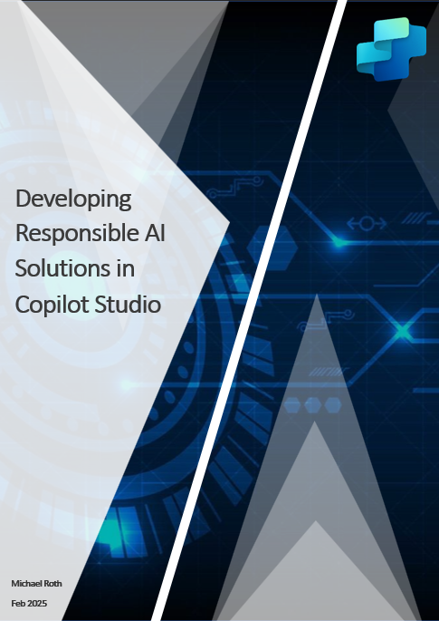
Take it with you
Yayyy, free stuff 😁
Free chapter
Notes:
We started this session with some of the worst-case scenarios of AI — from hallucinations to manipulation.
Then we looked at what it actually means to build responsible agents — and how it’s not just about scary headlines or vague ethics panels.
It’s about settings. It’s about choices. It’s about how we build, guide, and use these tools in the real world — right now.
And if open-source has taught us anything, it’s this: You don’t need permission to make change.
The way we design and document our agents, the way we prompt them, the way we review their impact — that’s how we shape the future of AI in our organizations. ‘
We are no longer just users of AI. We’re co-authors. Co-creators. And whether we like it or not — co-responsible.”

Slide 28
Q&A & Discussion
www.MichaelRoth42.com
www.control42.com
Michael.Roth@Gezeitenbrand.de
/michaelroth42/
If there’s time left,
we can still talk about things ☺
@MichaelRoth42
github.com/MichaelRoth42
…or find me online
Michael Roth Manager Experience Tech

